Slide 1

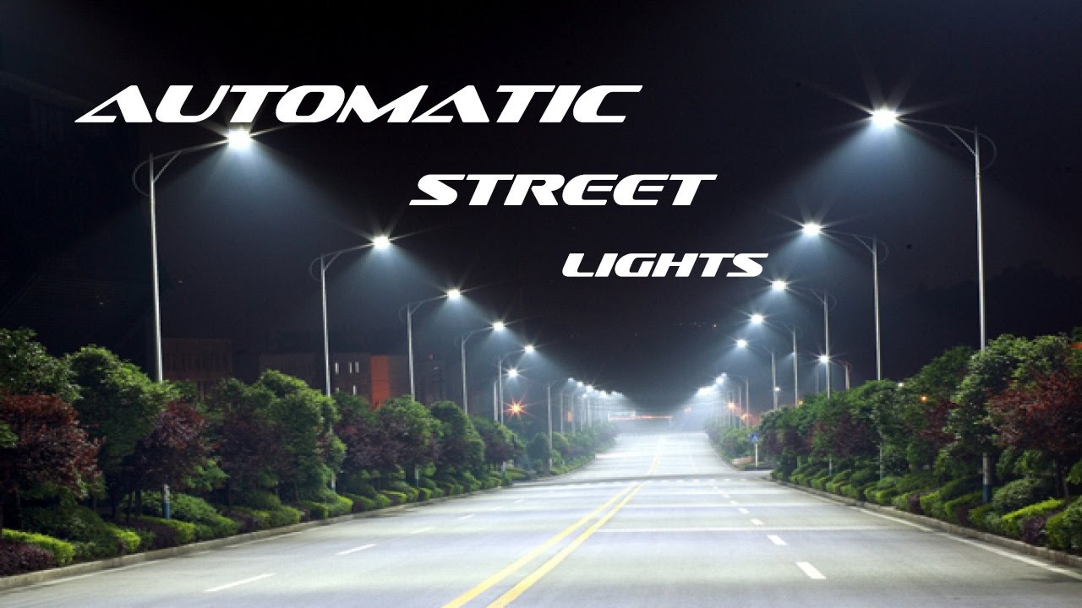
Project Name: Lumous Eye
Smart Energy-Saving Street Lighting System

Slide 2
Why Do We Need Intelligent Street Lighting?
1. Traditional streetlights stay ON all night → Huge energy waste
2. No response to motion, weather, or visibility
3. Poor lighting in fog, winter, or rainy conditions
4. High electricity cost for municipalities
5. No adaptive brightness → unsafe for pedestrians & vehicles

Slide 3
Project Objective
The Aim of Lumous Eye:
Reduce energy consumption by 80–90%
Automatically adjust lighting based on environment
Provide lighting only when required
Improve safety on highways & streets
Low-cost IoT-based solution usable at scale

Slide 4
System Overview
A Fully Automated Smart Lighting Solution
Lumous Eye uses:
LDR → Night detection
PIR/IR Sensors → Motion detection
DHT11 → Temperature + Humidity monitoring
Timer Logic → 5-second hold
Arduino (x2) → Master–Slave control
The system adapts instantly to motion and weather.

Slide 5
Key Features
🌙Night-Only Mode (LDR based)
🚶 Motion-Driven Streetlights
⏱️ 5-second Intelligent Delay
🌫️ Fog / Rain / Winter Safety Mode
⚡ High Energy Efficiency
🔧 Low-Cost & Scalable Architecture

Slide 6
Hardware Architecture
Master Arduino
Reads LDR (Day/Night)
Reads DHT11 (Temp + Humidity)
Sends environmental status → Slave
Slave Arduino
Reads PIR/IR sensors (3 lights)
Controls 4 street lamps
Implements 5-second delay logic
Communication
Digital pins OR serial between Arduinos
Common ground for system stability

Slide 7
Work flow
Step-by-Step Operation:
1️⃣ LDR — Day/Night Detection
Day → Lights OFF
Night → System activated
2️⃣ PIR/IR Motion Detection
Detects vehicle/pedestrian
Sends HIGH to controller
3️⃣ 5-Second Intelligent Delay
Light stays ON for 5 seconds
Prevents flickering when people move fast
4️⃣ Weather-Based Safety Mode
Triggers dim light when:
Temperature < 20°C (winter)
Humidity high (fog/rain)

Slide 8
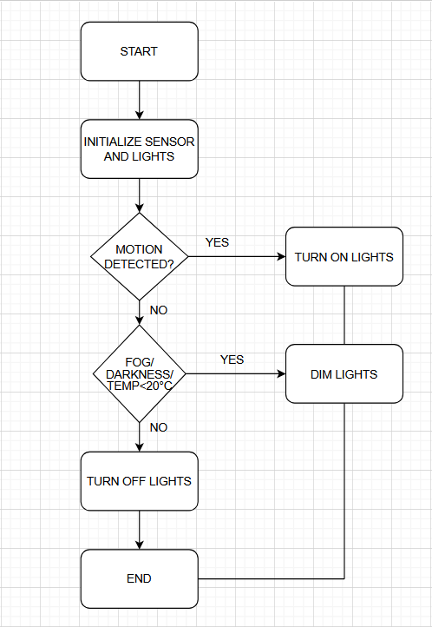

Slide 9
What We Achieved:
80–90% reduction in power usage
No light ON during day
Smooth ON/OFF lighting
Enhanced visibility in fog/rain/winter
Reliable multi-light control
Highly scalable and cheap to deploy

Slide 10
Future Improvements
Next Possible Upgrades:
Solar-powered version
Cloud connectivity (IoT dashboard)
ML-based vehicle speed estimation
Emergency flashing mode
Automatic brightness/traffic-level scaling

Slide 11
Important links
GitHub link: https://github.com/Komalsingh7/Lumous_EyeGroupNo_9.git
Video link: https://youtu.be/1hxaNWZarEw

Slide 12
1.Dona Banerjee (20233123)
2.Venkata Kavya Sri Gurram(20233133)
3.Heeramani Gowthami(20233143)
4.Jyotsana Verma(20233153)
5.Jyoti Meena(20233152)
6.Kesiya Wilson(20233528)
7.Khushi Chandra(20233340)
8.Khushi Choudhary(20233162)
9.Kirti Srivastava(20233163)
10.Komal Singh(20233164)
11.Kratika Srivas(20233167)
Team Members

